Slide 1




APR
25
Mocking Backend APIs
Notes:
https://docs.microsoft.com/en-us/dotnet/csharp/expression-trees-translating
Going to look at
Building
Compiling
Traversing

Slide 2
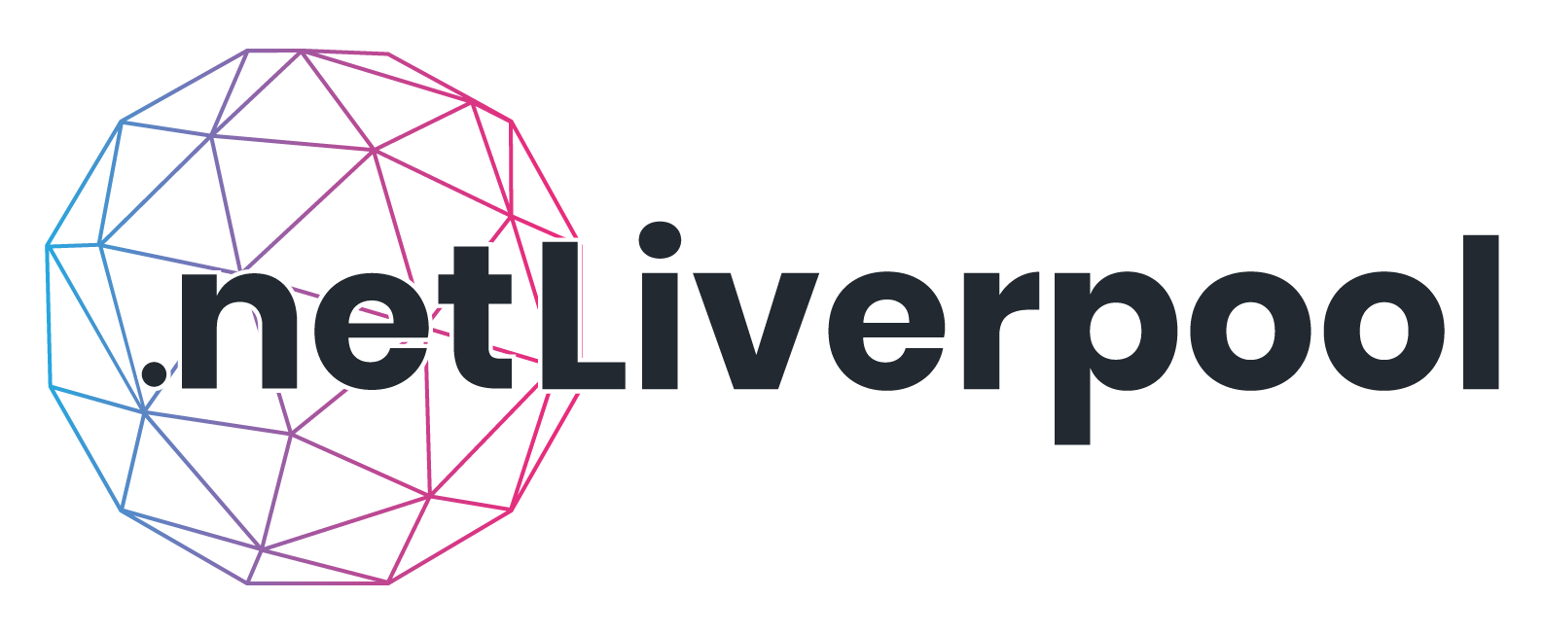
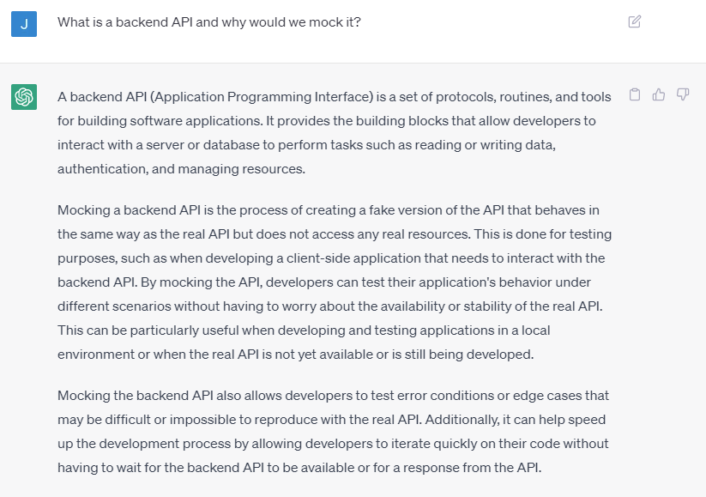
What is a backend API and why would we mock it?

Slide 3
Backend API:
A set of protocols, routines, and tools for building software applications
Provides building blocks for interacting with a server or database
Used for tasks such as reading or writing data, authentication, and managing resources
Mocking a backend API:
Creating a fake version of the API that behaves in the same way as the real API but does not access any real resources
Done for testing purposes, such as when developing a client-side application that needs to interact with the backend API
Allows testing of different scenarios without worrying about availability or stability of the real API
Useful for testing error conditions or edge cases that may be difficult or impossible to reproduce with the real API
Can speed up development process by allowing quick iteration on code without waiting for the backend API.

Slide 4
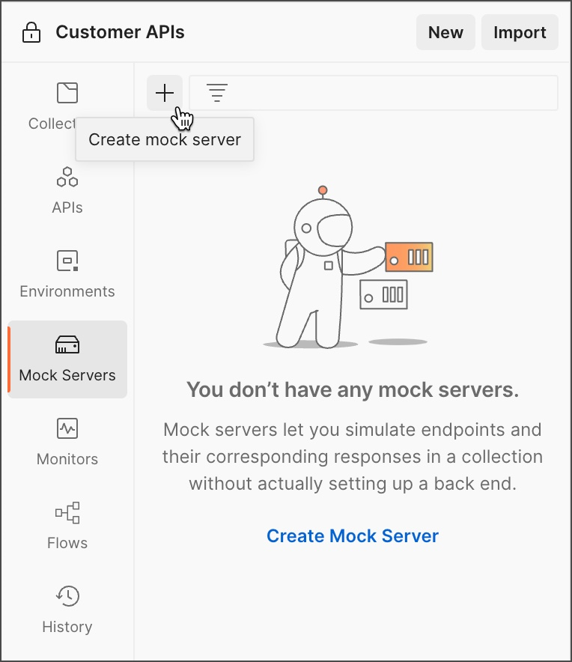
Option One - Postman Mock API
https://learning.postman.com/

Slide 5
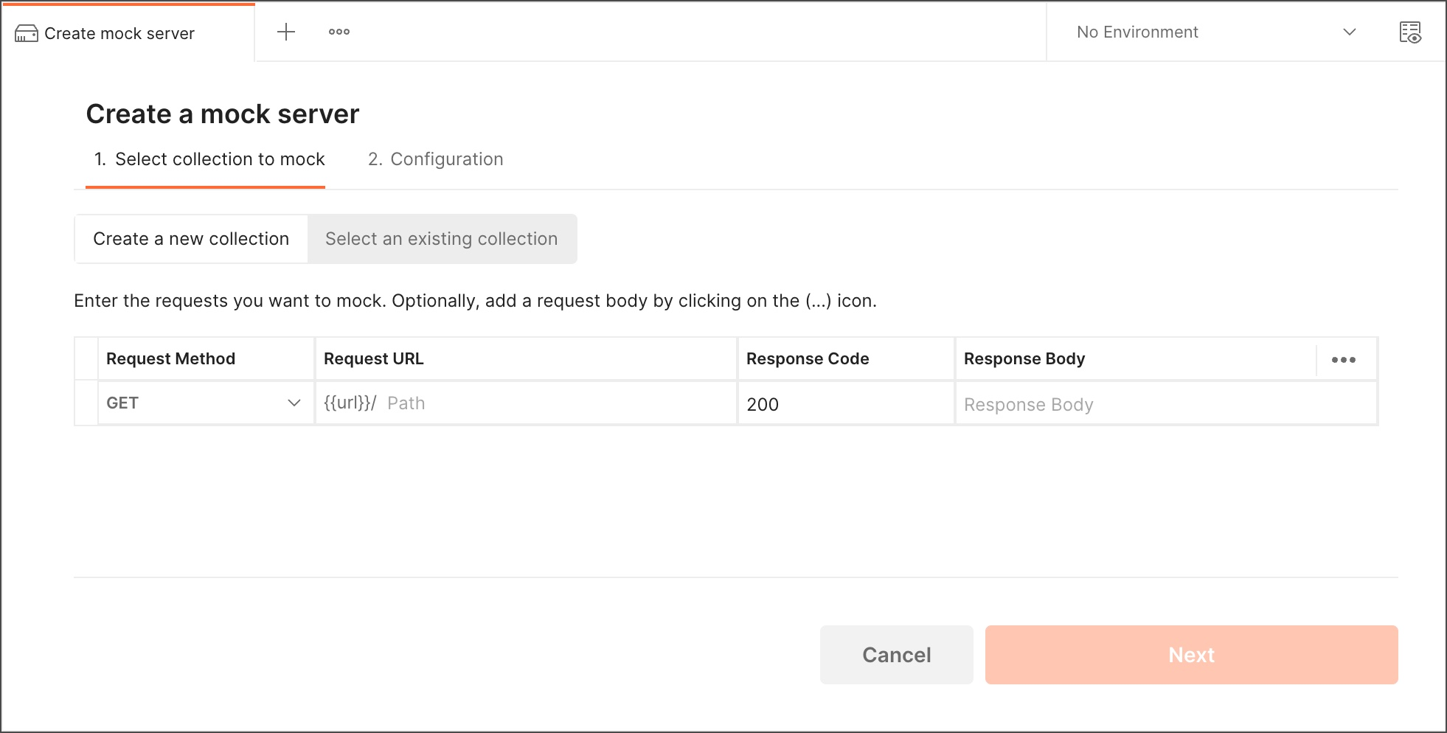
Option One - Postman Mock API

Slide 6
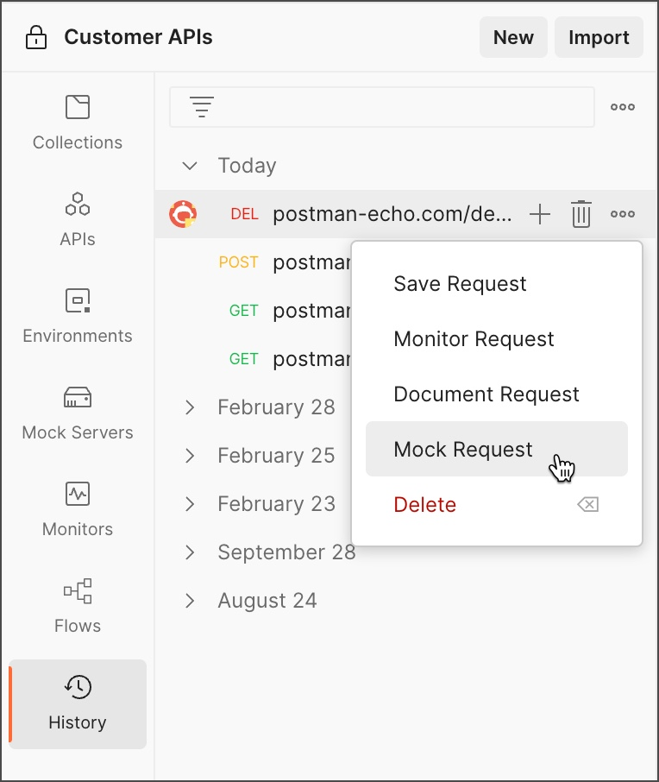
Option One - Postman Mock API

Slide 7
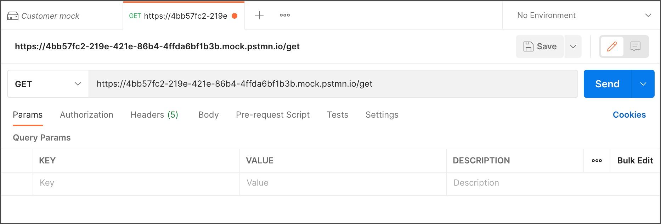
Option One - Postman Mock API

Slide 8
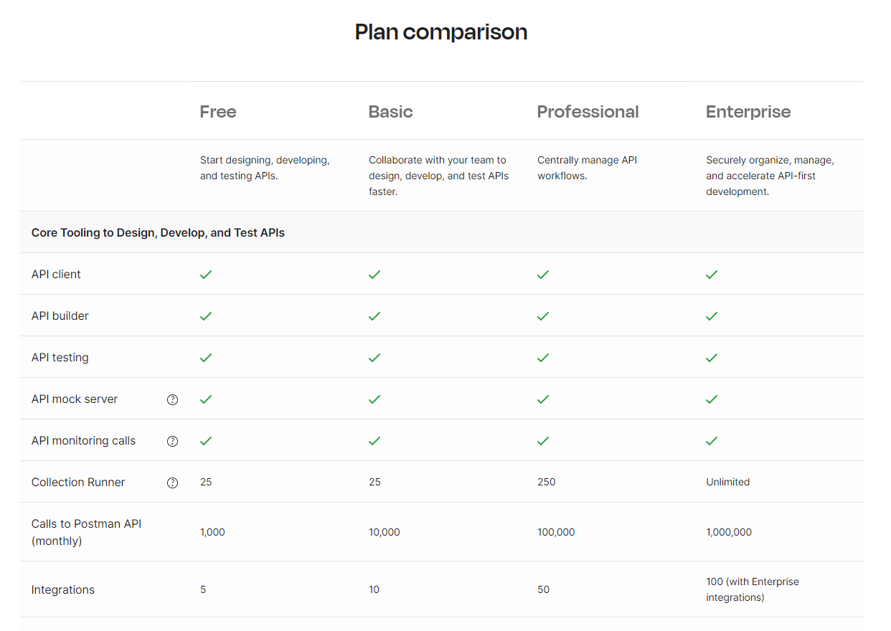

Slide 9
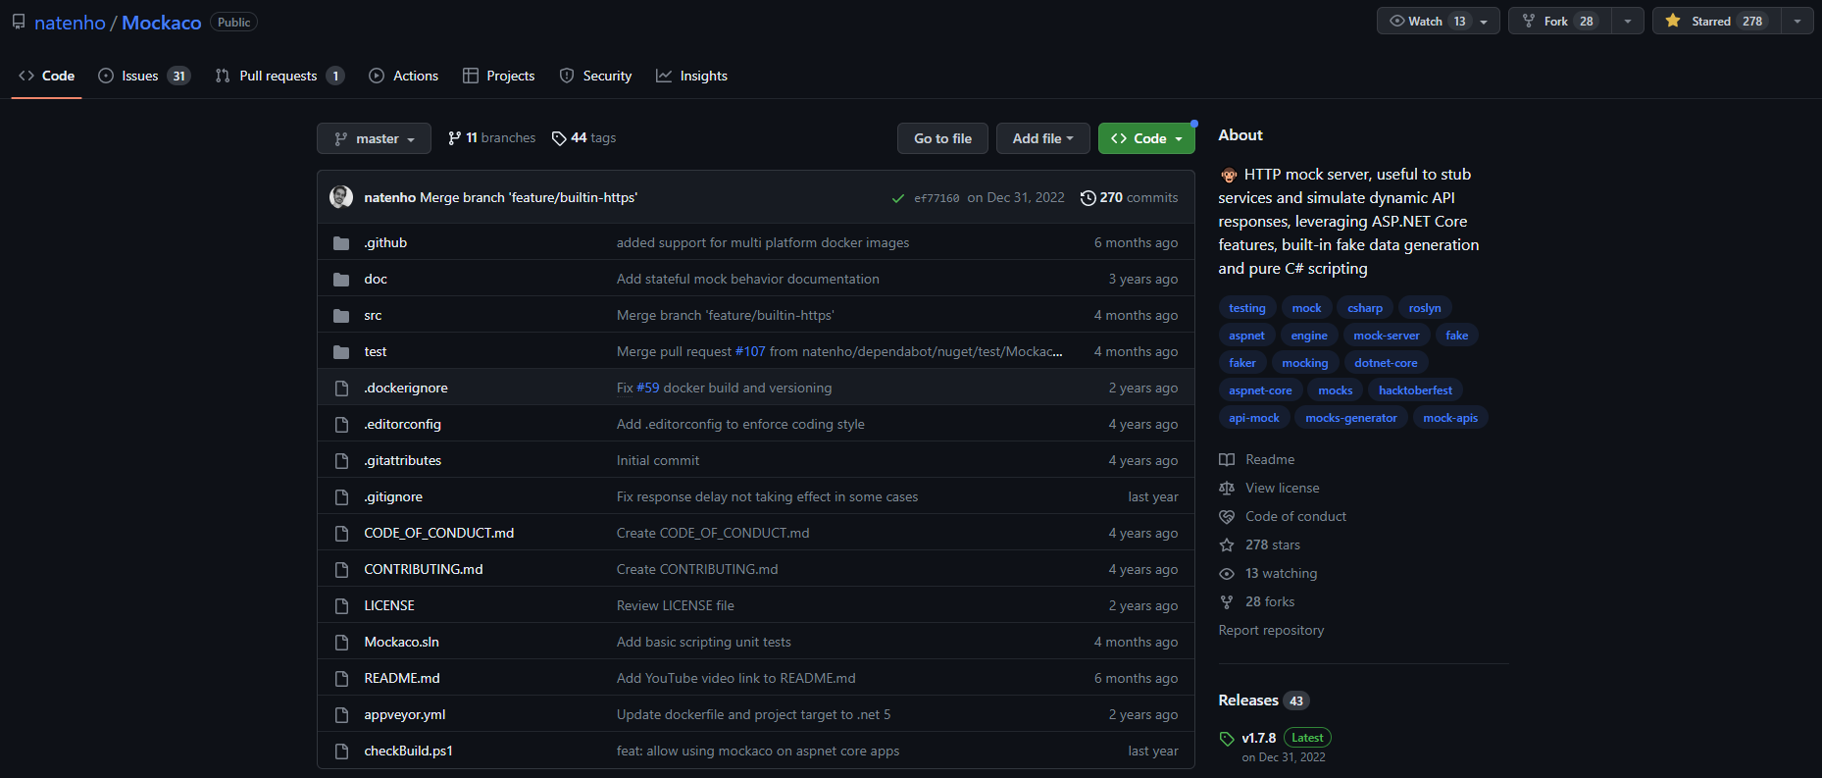
Option Two - Mockaco
https://github.com/natenho/Mockaco

Slide 10
Sure! The Github repo "Mockaco" provides a platform for mocking HTTP/HTTPS APIs. Here's a summary of the key features and benefits:
- Mockaco allows you to define API endpoints and their expected responses in a simple JSON file.
- It supports dynamic responses, allowing you to return different responses based on the request parameters.
- You can also define response delays, errors, and timeouts to test how your application handles these scenarios.
- Mockaco provides a web interface for managing your mocked APIs and viewing request logs.
- It can be run as a standalone server or embedded into your application using a library.
- Mockaco can be used for testing and development purposes, allowing you to simulate the behavior of real APIs without relying on external services.
- The platform is open-source and actively maintained, with contributions from the community.
- Mockaco supports SSL/TLS for secure communication and can be configured to run behind a reverse proxy server.
Overall, Mockaco is a powerful tool for developers who need to mock APIs for testing and development purposes. Its ease of use, flexibility, and support for dynamic responses make it a valuable addition to any developer's toolkit.

Slide 11
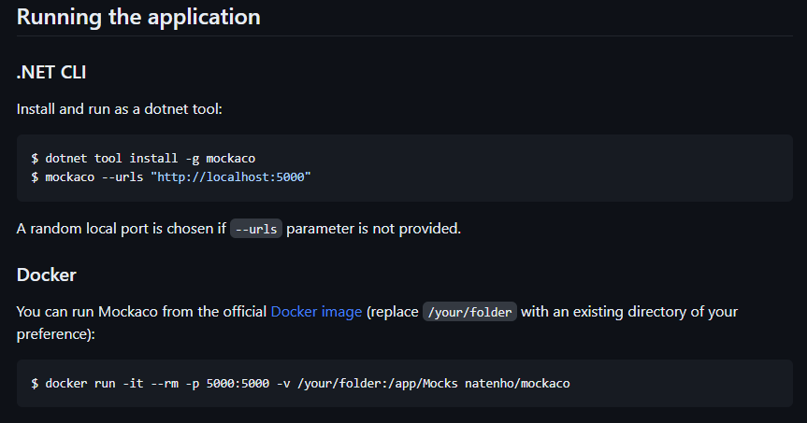

Slide 12
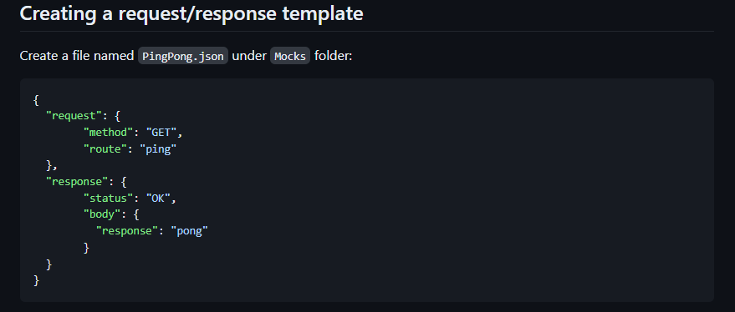

Slide 13
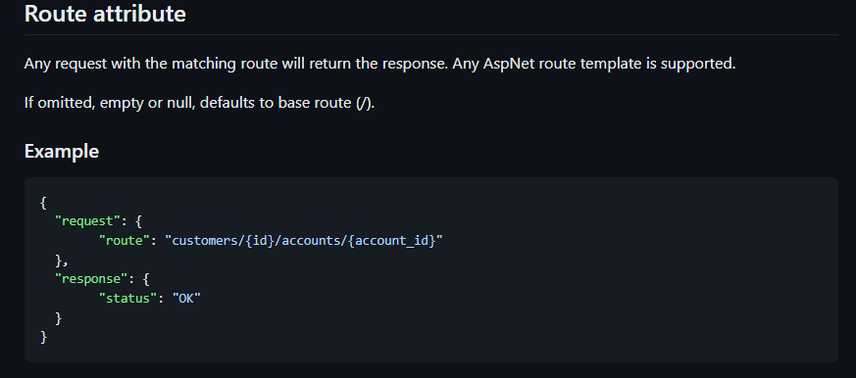

Slide 14
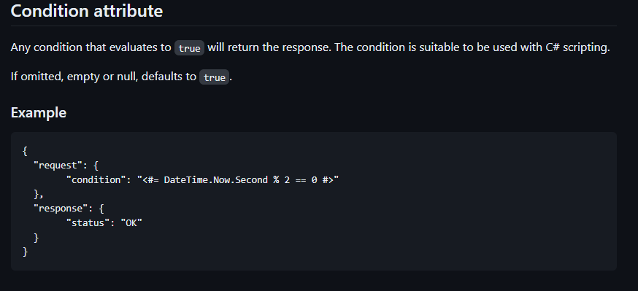

Slide 15
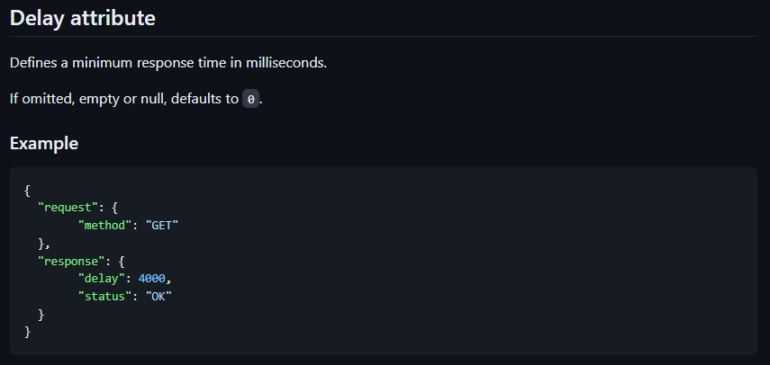

Slide 16
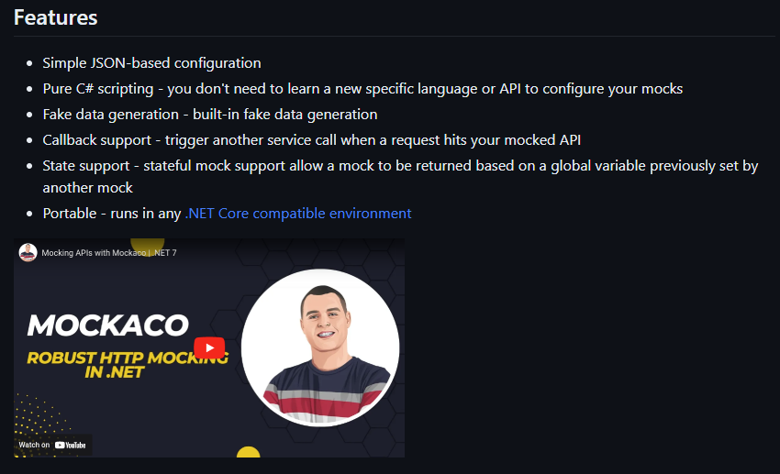

Slide 17




Slide 18


Slide 19
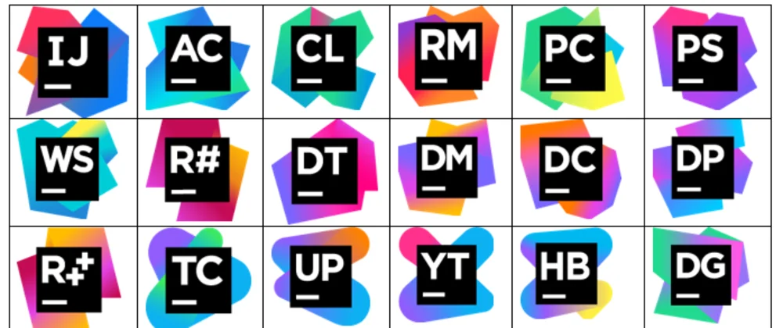

Slide 20
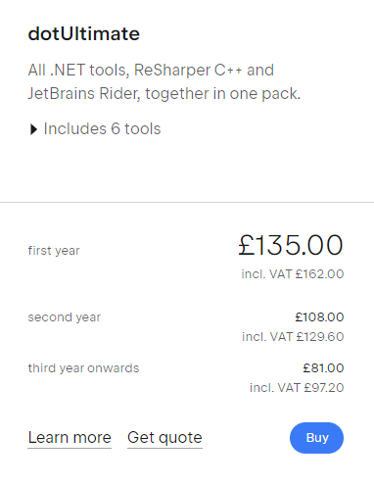
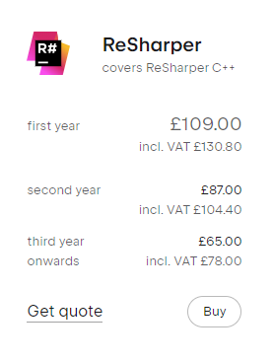
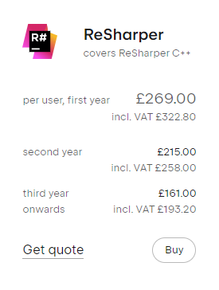
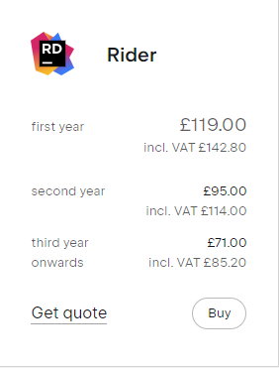

Slide 21

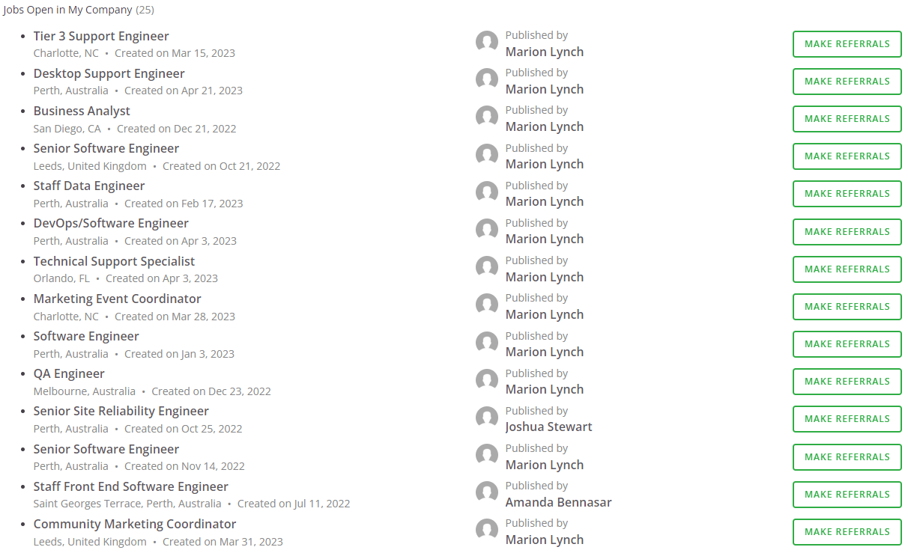
Open Vacancies at Smoothwall

